Slide 1

Analysis of Iterative Signal Deconvolution Algorithms And Their Sensitivity to Noise Based on Simulated Full-Waveform Lidar data
Ramesh Bhatta
CIS RIT Imaging Science PhD Program,
Rochester Institute of Technology
Rochester, New York
10/09/2025

Slide 2
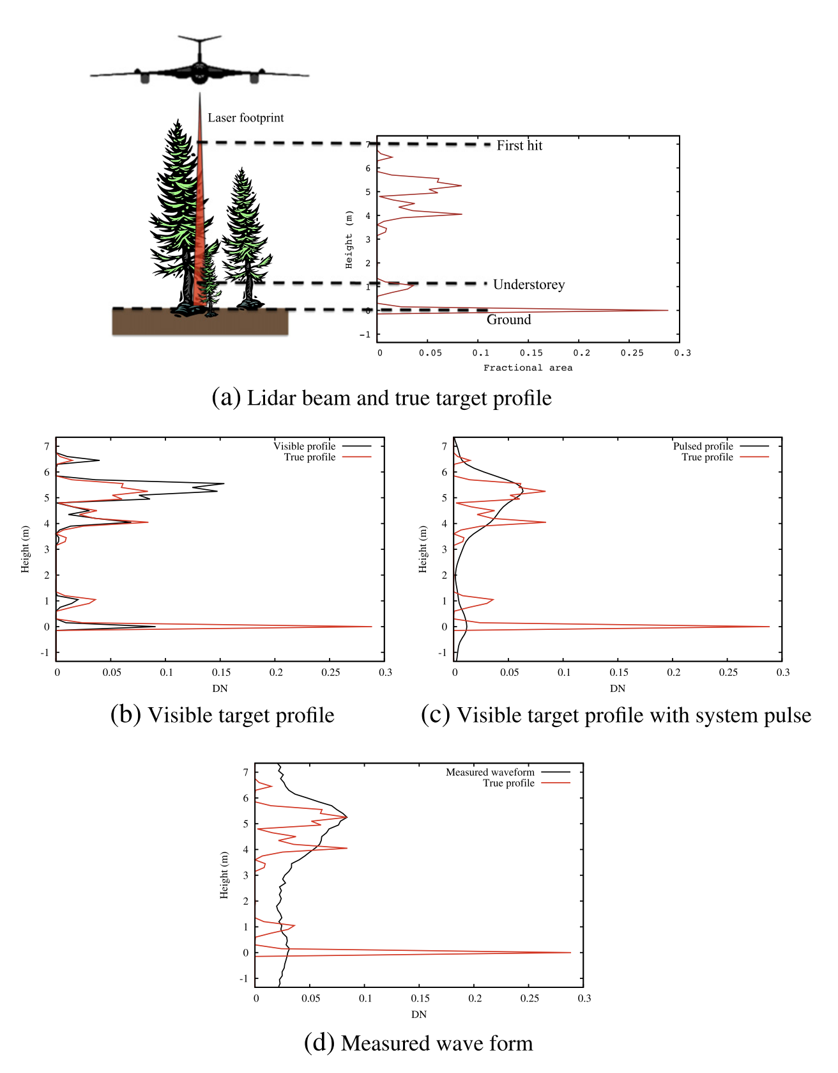
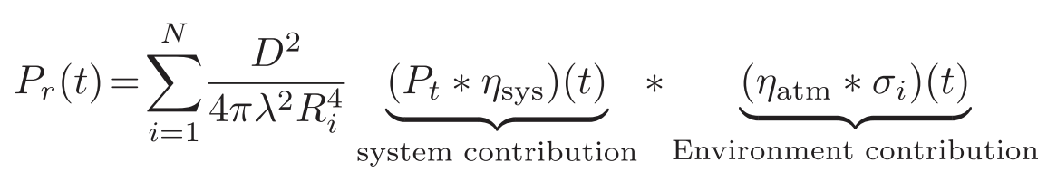
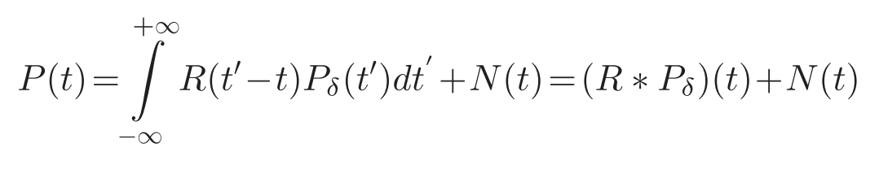
Introduction
Effect of system on waveform detection
R(t) = P_{t}(t) * ⍴(t)
Where,
⍴(t) is the system impulse response.
And R(t) can be estimated from the return from lambertian surface (or flat-ground) .
Ref: Figure 1. Hancock et al. (2017)

Slide 3
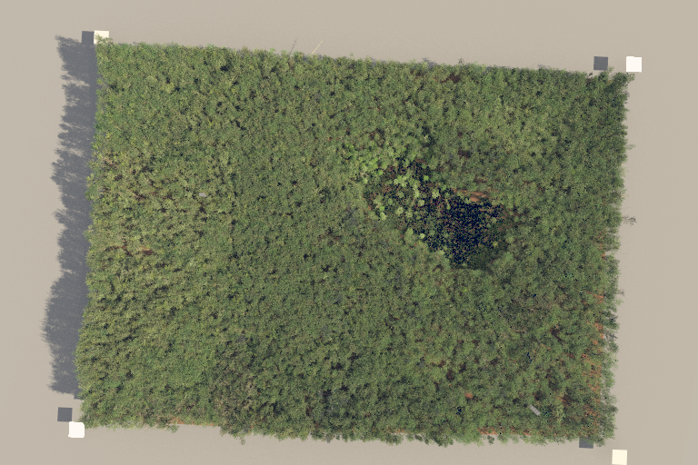
DIRSIG waveform lidar simulation
Simulation configuration:
Flight height: 1000m
Footprint area: 1m² (At Nadir)
Pixel size: 50 microns
Scan type: Line scan
Tx. Spectral line center and width (Assuming Gaussian): 1064 nm, 1 nm
Tx. Pulse duration (ns): 2 (truth), 4, 8, 10 (LVIS), 16
Tx. Pulse Energy (joules): 5 mJ
Sampling rate: 1ns
Rx. Spectral bandpass: 10 nm (10x tx. bandpass) (sampling delta = 1/10th tx width)
And other settings based on requirement.
Fig: Harvard Forest virtual scene

Slide 4
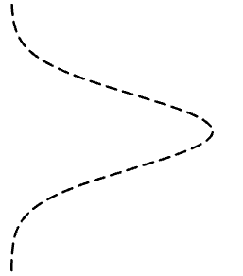
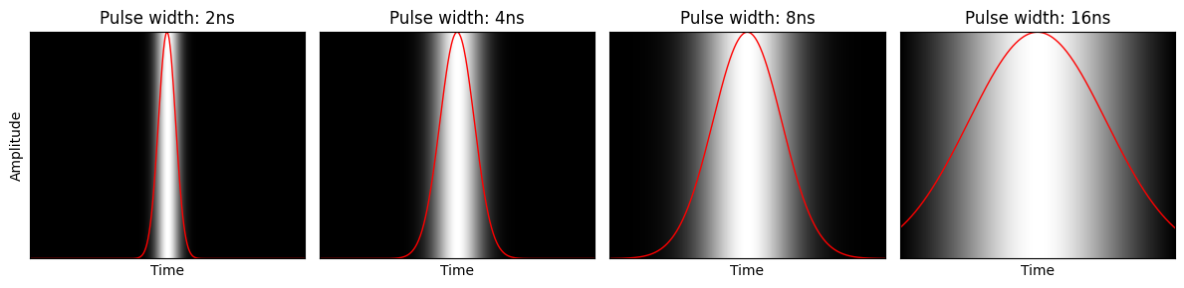
Waveform Collection
(Lidar Scanning)
Lidar Footprint
Gaussian Beam profile
5m pixels
Pulse
width
Square Pixel
(~ 95% of energy return)
Fig: Energy distribution variation for multiple Gaussian pulse widths Lower pulse width produce higher vertical resolution and vice versa

Slide 5
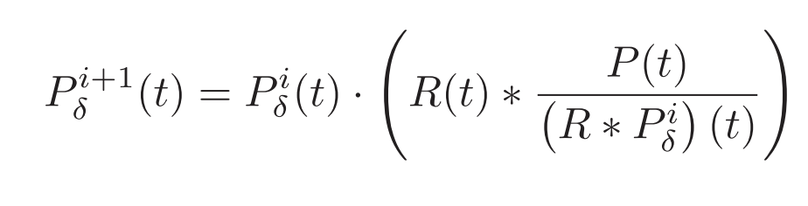

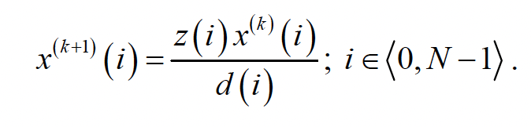
Deconvolution Algorithms
Method I: Richardson Lucy Algorithm
Variation: Boosted deconvolution
Iterative solution based on Bayes theorem:
Boosting
After ‘n’ iterations, raise the signal output by some power (boosting factor).
Repeat this ‘R’ times.
Boosts the signal to higher levels and helps convergence faster.
However caution need to be taken while applying to noisy signal.
Method II: Gold algorithm
( Morháč M. et al)
here,
z = H^{T}y and
d = Tx = H^{T}Hx
and H represent system convolution matrix such that:
y = Hx represents the deconvolution problem.

Slide 6
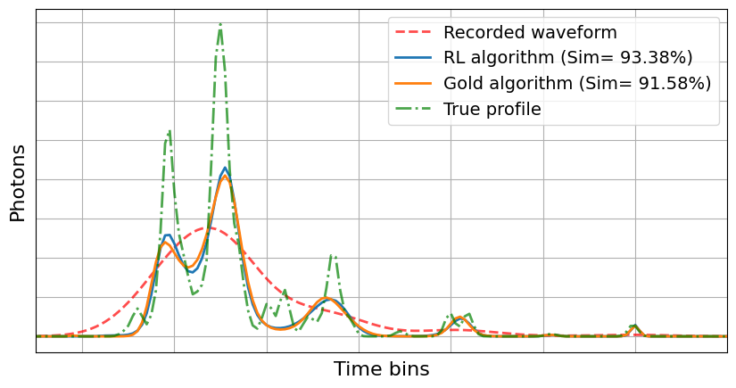
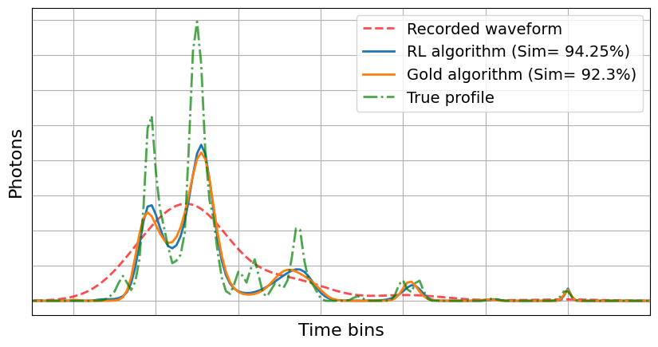
Results
Fig: RL and Gold deconvolution Algorithm output
(16ns recorded response, 2ns response as truth, 100000 iterations)
Fig: Boosted: RL and Gold deconvolution Algorithm output
(16ns recorded response, 2ns response as truth, 20000 iterations, 5 repetitions, bc =1.25)

Slide 7

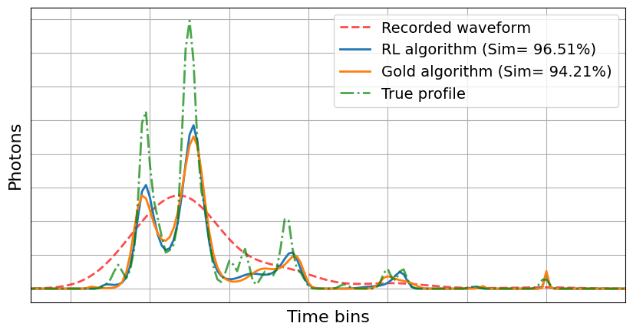
Fig: RL and Gold deconvolution Algorithm output
(16ns recorded response, 2ns response as truth, 500000 iterations)
Fig: Boosted: RL and Gold deconvolution Algorithm output
(16ns recorded response, 2ns response as truth, 100000 iterations, 5 repetitions, bc =1.25)

Slide 8
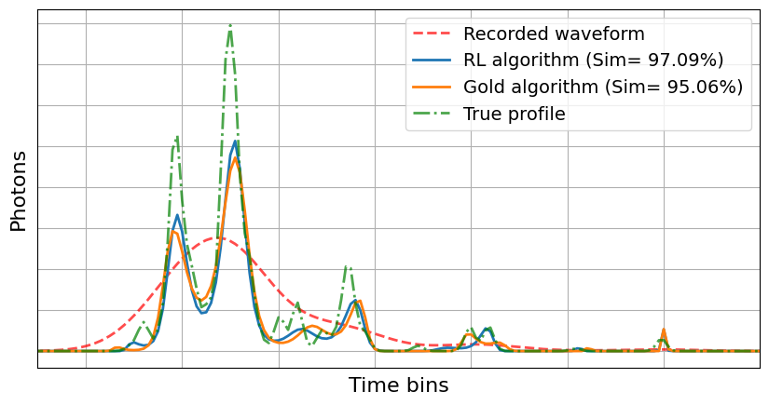
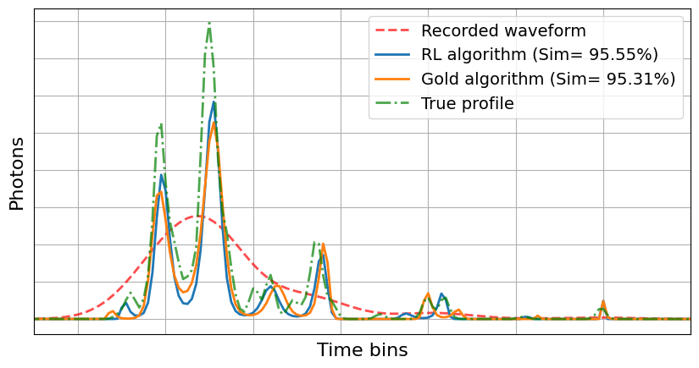
Fig: Boosted: RL and Gold deconvolution Algorithm output
(16ns recorded response, 2ns response as truth, 100000 iterations, 5 repetitions, bc = 1.5)
Fig: Boosted: RL and Gold deconvolution Algorithm output
(16ns recorded response, 2ns response as truth, 100000 iterations, 5 repetitions, bc =2)

Slide 9
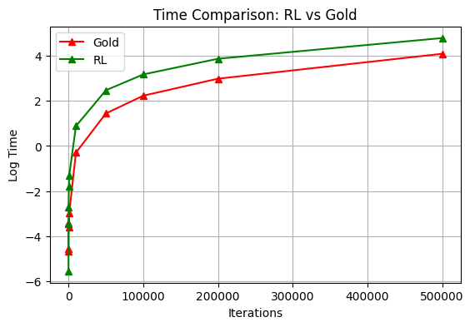

Fig: RL and Gold deconvolution Algorithm output
(16ns recorded response, 2ns response as truth, 1000000 iterations)

Slide 10
Comments:
Higher number of Iteration leads to better solution but need greater computation time and memory.
Can use residual convergence as stopping criteria
Both algorithm still miss to detect some smaller and close peaks even for high number of iterations.
Gold algorithm results similar accuracy as RL algorithm however computation time reduced.
Boosting makes the solution to converge fast within few iterations.
However the ‘Boosting coefficient’ need to be chosen carefully since high boosting cause the width of detected peaks to become ‘thinner’.
With a “suitable” boosting coefficient, Higher number of iterations can reveal the structures that couldn’t be seen in previous variations of RL and Gold algorithms*.
Question is: How do we determine that “suitable” boosting parameter?
Empirically!!!
Since when we want to boost the peaks in the spectrum ‘Boosting coefficient’ should be greater than 1.
otherwise, the peaks would be suppressed (smoothed) and consequently the resolution decreased.
For our simulated and smooth waveform data boosting parameter between 1 < p < 3 works well. Higher value of the parameter tends to suppress the peak width. Specifically a boosting factor of 1.25 produced highest mean cosine similarity calculated using 100 deconvolved waveforms and their corresponding truth for both RL and Gold deconvolution algorithm.

Slide 11
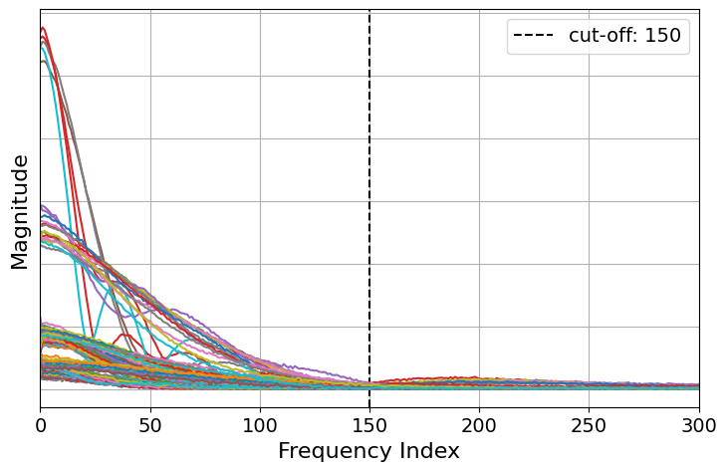
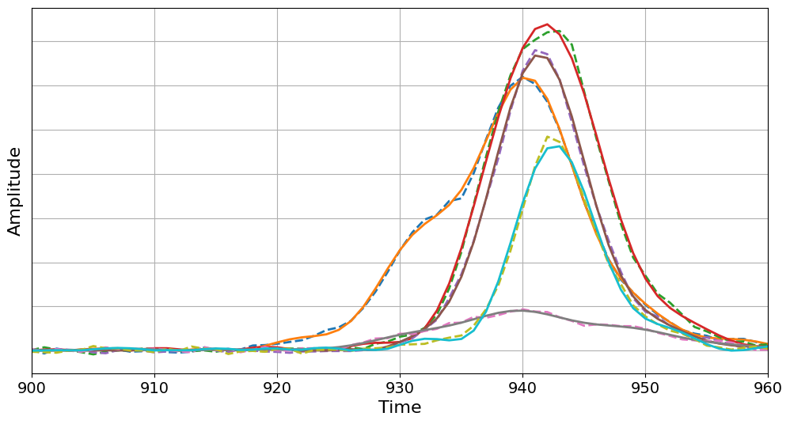
Noise Sensitivity
Adding noise to simulated waveforms using real LVIS data:
Fig: Magnitude vs Frequency of real waveforms
(250 waveforms, LVIS)
Fig: Sample of waveforms in original (continuous line) and denoised form(dashed)
(250 waveforms, LVIS)

Slide 12
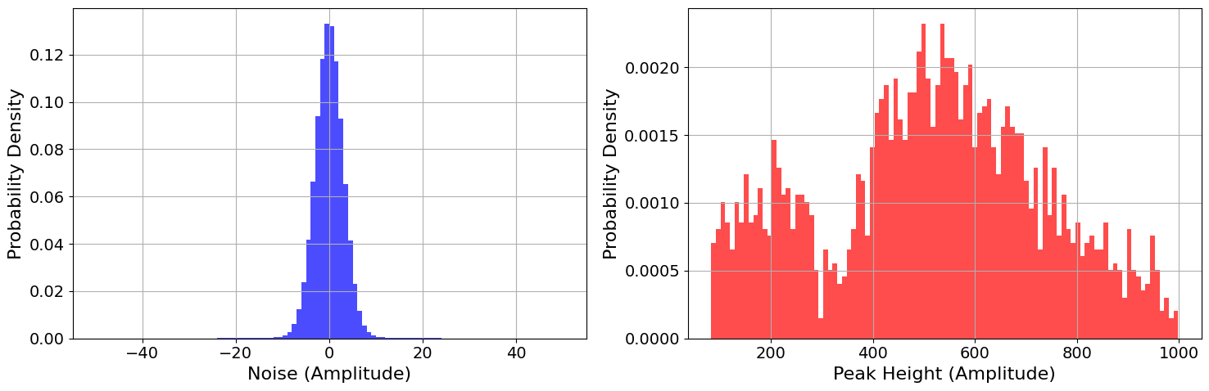
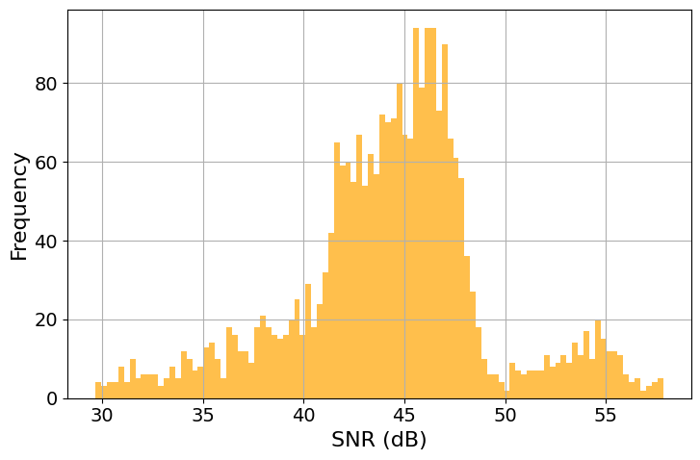
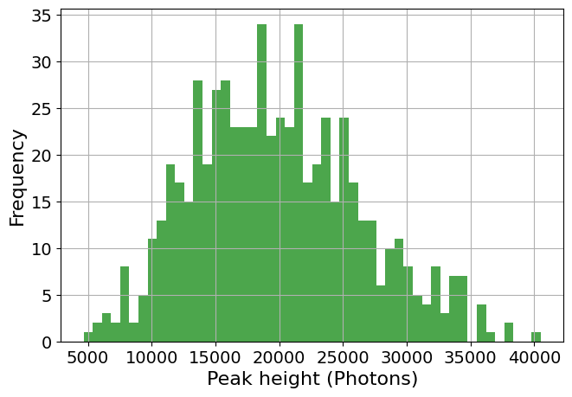

Slide 13
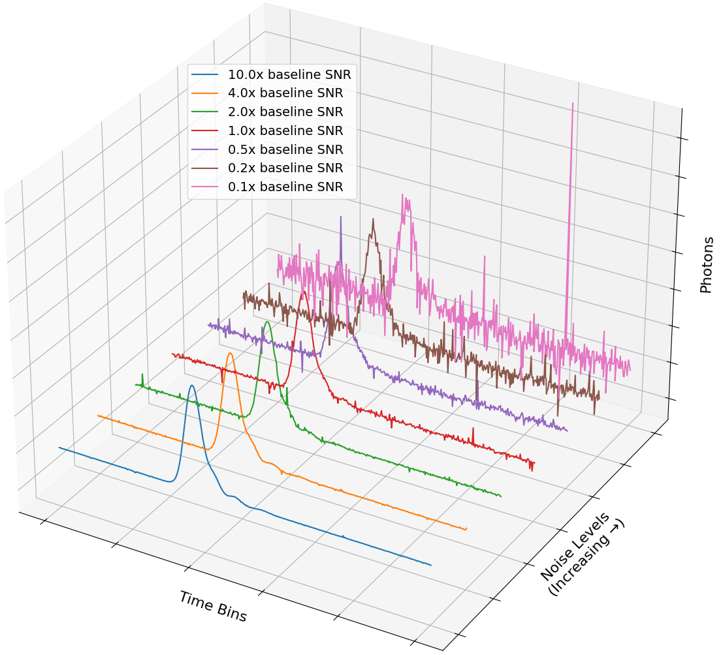
Fig: Noise added sample waveform
(multiple noise levels)

Slide 14
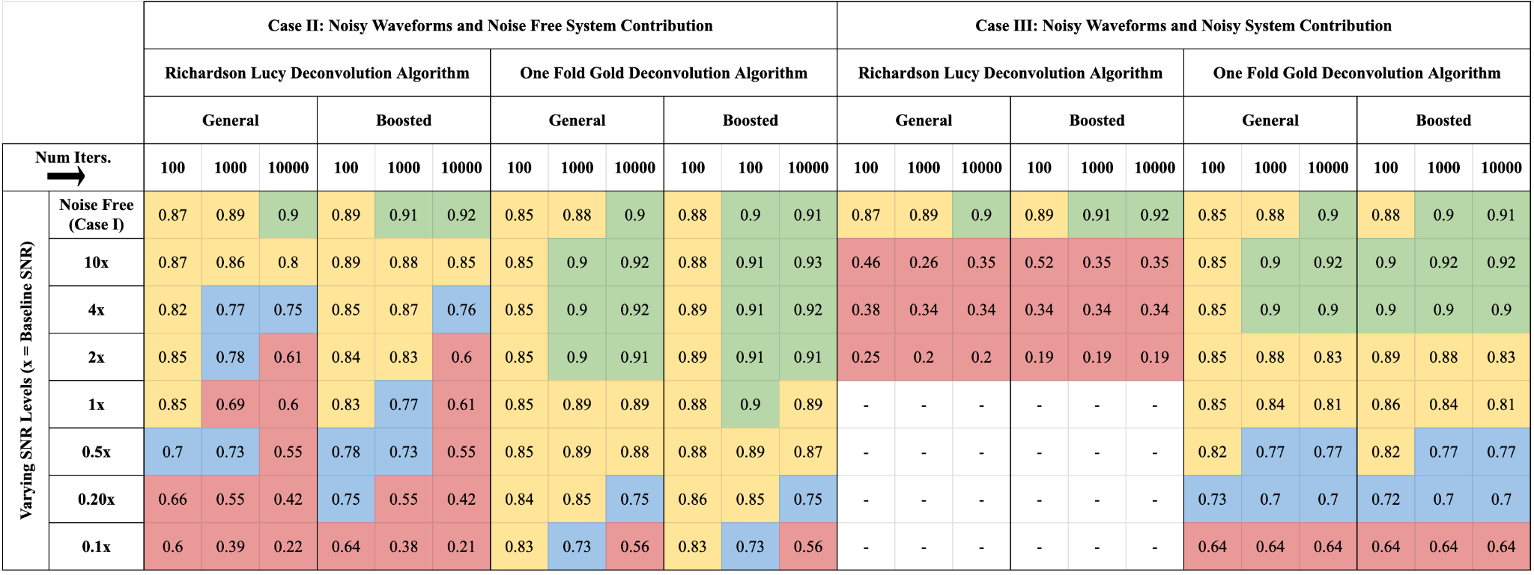
Result: Algorithms performance
Fig: Mean similarity at different noise levels for Richardson Lucy and Gold deconvolution algorithm

Slide 15
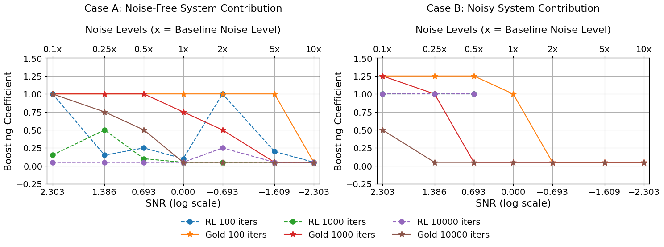
Result: Choosing a “best” boosting coefficient !!!

Slide 16
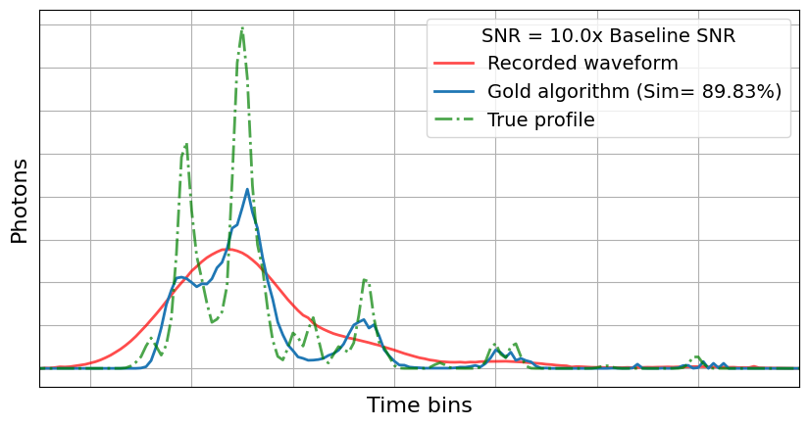
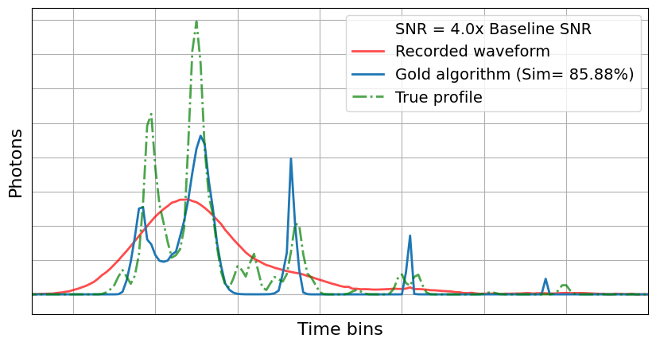
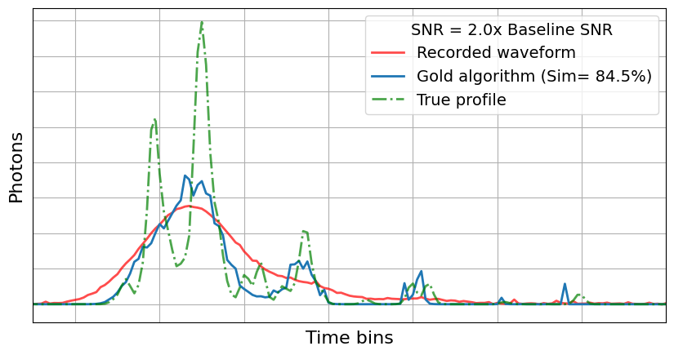
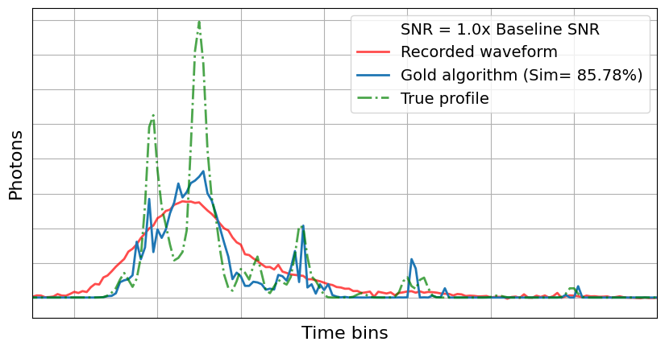
Extra Results: How Similarity looks like!!

Slide 17
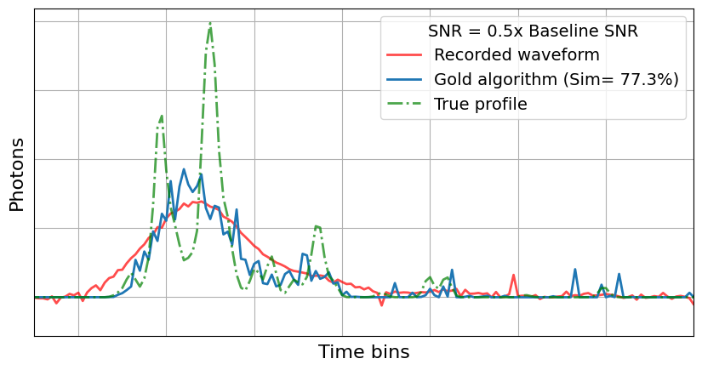
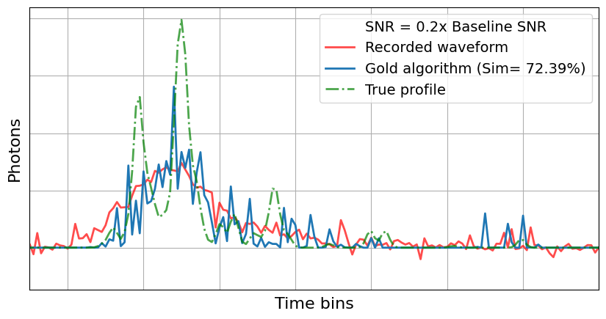
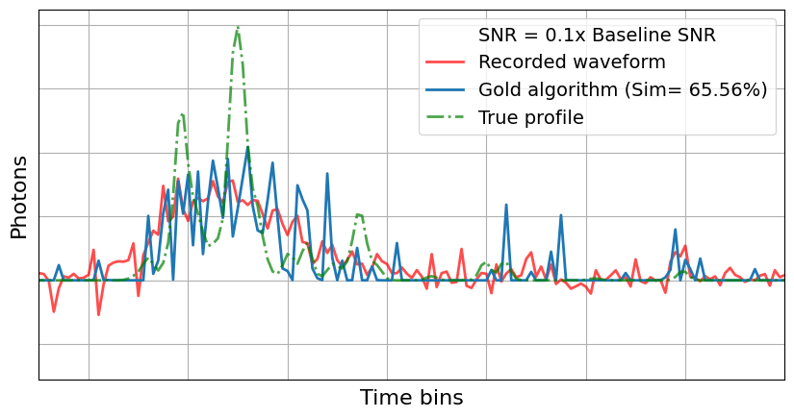

Slide 18
